Slide 1

Informed search algorithm
Eng. Khaled Mohammed Abd-Elgaber
Khaled.edu.engineer@gmail.com

Slide 2
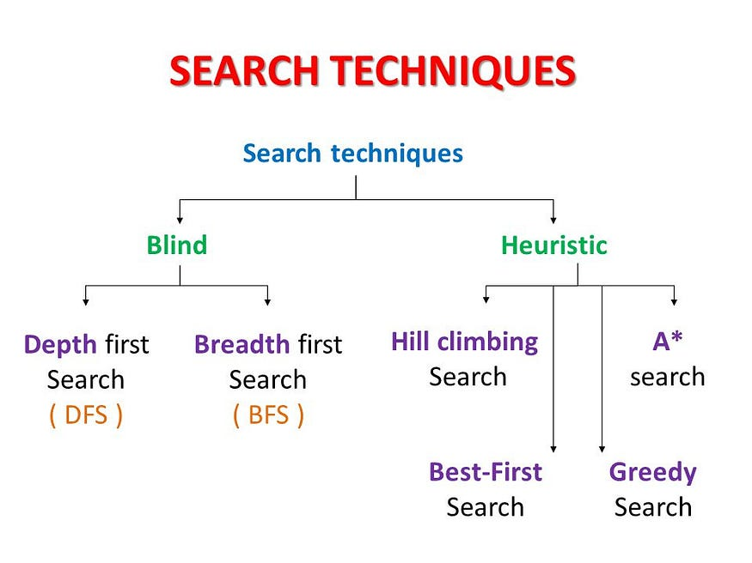
introduction
Informed search
tries to reduce the amount of search that must be done by making intelligent choices for the nodes that are selected for expansion.
This implies the existence of some way of evaluating the likelihood that a given node is on the solution path.
In general, this is done using a heuristic function.

Slide 3
Local Search
local search is a heuristic method for solving computationally hard optimization problems.
Local search can be used on problems that can be formulated as finding a solution maximizing a criterion among a number of candidate solutions.
Examples:
Hill Climbing
Simulated Annealing
Genetic Algorithm

Slide 4
Hill Climbing

Slide 5
introduction
It belongs to the family of local search algorithms and is often used in optimization problems where the goal is to find the best solution from a set of possible solutions.
Hill Climbing is a heuristic search used for mathematical optimization problems in the field of Artificial Intelligence.
Given a large set of inputs and a good heuristic function, it tries to find a sufficiently good solution to the problem.
This solution may not be the global optimal maximum.
In the above definition, mathematical optimization problems imply that hill-climbing solves the problems where we need to maximize or minimize a given real function by choosing values from the given inputs.
For example traveling salesman problem where we need to minimize the distance traveled by the salesman.
‘Heuristic search’ means that this search algorithm may not find the optimal solution to the problem. However, it will give a good solution in a reasonable time.
A heuristic function is a function that will rank all the possible alternatives at any branching step in the search algorithm based on the available information. It helps the algorithm to select the best route out of possible routes.

Slide 6
How does hill climbing work?
In Hill Climbing, the algorithm starts with an initial solution and then iteratively makes small changes to it in order to improve the solution.
These changes are based on a heuristic function that evaluates the quality of the solution.
The algorithm continues to make these small changes until it reaches a local maximum, meaning that no further improvement can be made with the current set of moves.
There are several variations of Hill Climbing, including
steepest ascent Hill Climbing,
In steepest ascent Hill Climbing, the algorithm evaluates all the possible moves from the current solution and selects the one that leads to the best improvement.
first-choice Hill Climbing,
In first-choice Hill Climbing, the algorithm randomly selects a move and accepts it if it leads to an improvement, regardless of whether it is the best move.
simulated annealing.
Simulated annealing is a probabilistic variation of Hill Climbing that allows the algorithm to occasionally accept worse moves in order to avoid getting stuck in local maxima.

Slide 7
Application of hill climbing
Hill Climbing can be useful in a variety of optimization problems, such as
scheduling,
route planning, and
resource allocation.
However, it has some limitations, such as
the tendency to get stuck in local maxima and the lack of diversity in the search space.
Therefore, it is often combined with other optimization techniques, such as genetic algorithms or simulated annealing, to overcome these limitations and improve the search results.

Slide 8
Advantages and disadvantages of Hill Climbing algorithm:
Advantages:
Hill Climbing is a simple and intuitive algorithm that is easy to understand and implement.
It can be used in a wide variety of optimization problems, including those with a large search space and complex constraints.
Hill Climbing is often very efficient in finding local optima, making it a good choice for problems where a good solution is needed quickly.
The algorithm can be easily modified and extended to include additional heuristics or constraints.
Disadvantages:
Hill Climbing can get stuck in local optima, meaning that it may not find the global optimum of the problem.
The algorithm is sensitive to the choice of initial solution, and a poor initial solution may result in a poor final solution.
Hill Climbing does not explore the search space very thoroughly, which can limit its ability to find better solutions.
It may be less effective than other optimization algorithms, such as genetic algorithms or simulated annealing, for certain types of problems.

Slide 9
Types of Hill Climbing
1. Simple Hill climbing:
It examines the neighboring nodes one by one and selects the first neighboring node which optimizes the current cost as the next node.
Algorithm for Simple Hill climbing :
Evaluate the initial state. If it is a goal state then stop and return success. Otherwise, make the initial state as the current state.
Loop until the solution state is found or there are no new operators present which can be applied to the current state.
Select a state that has not been yet applied to the current state and apply it to produce a new state.
Perform these to evaluate the new state.
If the current state is a goal state, then stop and return success.
If it is better than the current state, then make it the current state and proceed further.
If it is not better than the current state, then continue in the loop until a solution is found.
Exit from the function.

Slide 10
Cont.
2. Steepest-Ascent Hill climbing:
It first examines all the neighboring nodes and then selects the node closest to the solution state as of the next node.
Algorithm for Steepest Ascent Hill climbing :
Evaluate the initial state. If it is a goal state then stop and return success. Otherwise, make the initial state as the current state.
Repeat these steps until a solution is found or the current state does not change
Select a state that has not been yet applied to the current state.
Initialize a new ‘best state’ equal to the current state and apply it to produce a new state.
Perform these to evaluate the new state
If the current state is a goal state, then stop and return success.
If it is better than the best state, then make it the best state else continue the loop with another new state.
Make the best state as the current state and go to Step 2 of the second point.
Exit from the function.

Slide 11
Cont.
3. Stochastic hill climbing:
It does not examine all the neighboring nodes before deciding which node to select.
It just selects a neighboring node at random and decides (based on the amount of improvement in that neighbor) whether to move to that neighbor or to examine another.
Algorithm for Stochastic hill climbing :
Evaluate the initial state. If it is a goal state then stop and return success. Otherwise, make the initial state the current state.
Repeat these steps until a solution is found or the current state does not change.
Select a state that has not been yet applied to the current state.
Apply the successor function to the current state and generate all the neighbor states.
Among the generated neighbor states that are better than the current state choose a state randomly (or based on some probability function).
If the chosen state is the goal state, then return success, else make it the current state and repeat step 2 of the second point.
Exit from the function.

Slide 12
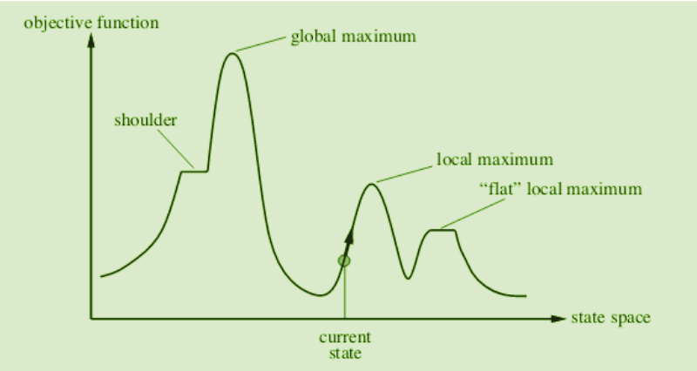
State Space diagram for Hill Climbing
The state-space diagram is a graphical representation of the set of states our search algorithm can reach vs the value of our objective function(the function that we wish to maximize).
X-axis: denotes the state space i.e. states or configurations our algorithm may reach.
Y-axis: denotes the values of objective function corresponding to a particular state.
The best solution will be a state space where the objective function has a maximum value(global maximum).

Slide 13
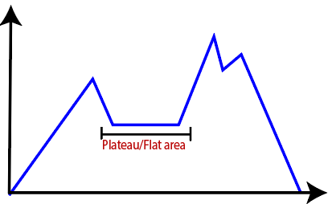
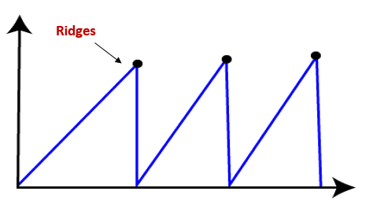
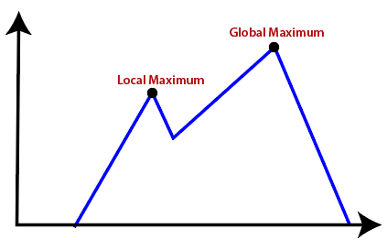
Different regions in the State Space Diagram:
Local maximum: It is a state which is better than its neighboring state however there exists a state which is better than it(global maximum). This state is better because here the value of the objective function is higher than its neighbors.
Global maximum: It is the best possible state in the state space diagram. This is because, at this stage, the objective function has the highest value.
Plateau/flat local maximum: It is a flat region of state space where neighboring states have the same value.
Ridge: It is a region that is higher than its neighbors but itself has a slope. It is a special kind of local maximum.
Current state: The region of the state space diagram where we are currently present during the search.
Shoulder: It is a plateau that has an uphill edge.

Slide 14
Problems in different regions in Hill climbing
Hill climbing cannot reach the optimal/best state(global maximum) if it enters any of the following regions :
Local maximum:
At a local maximum, all neighboring states have a value that is worse than the current state. Since hill-climbing uses a greedy approach, it will not move to the worse state and terminate itself. The process will end even though a better solution may exist.
To overcome the local maximum problem:
Utilize the backtracking technique. Maintain a list of visited states.
If the search reaches an undesirable state, it can backtrack to the previous configuration and explore a new path.
Plateau:
On the plateau, all neighbors have the same value. Hence, it is not possible to select the best direction.
To overcome plateaus:
Make a big jump. Randomly select a state far away from the current state.
Chances are that we will land in a non-plateau region.
Ridge:
Any point on a ridge can look like a peak because movement in all possible directions is downward.
Hence the algorithm stops when it reaches this state.
To overcome Ridge:
In this kind of obstacle, use two or more rules before testing.
It implies moving in several directions at once.

Slide 15
Python implementation
def hill_climbing(f, x0):
x = x0 # initial solution
while True:
neighbors = generate_neighbors(x) # generate neighbors of x
# find the neighbor with the highest function value
best_neighbor = max(neighbors, key=f)
if f(best_neighbor) <= f(x): # if the best neighbor is not better than x, stop
return x
x = best_neighbor # otherwise, continue with the best neighbor

Slide 16
Simulated Annealing

Slide 17
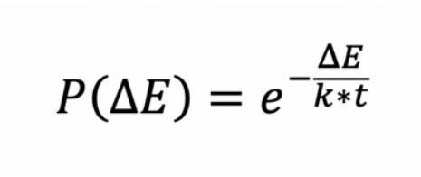
What is Physical Annealing?
The Simulated Annealing algorithm is based upon Physical Annealing in real life.
Physical Annealing is the process of heating up a material until it reaches an annealing temperature and then it will be cooled down slowly in order to change the material to a desired structure.
When the material is hot, the molecular structure is weaker and is more susceptible to change. When the material cools down, the molecular structure is harder and is less susceptible to change.
Another important part of this analogy is the following equation from Thermal Dynamics:
This equation calculates the probability that the Energy Magnitude will increase. We can calculate this value given some Energy Magnitude and some temperature t along with the Boltzmann constant k.
This equation calculates the probability that the Energy Magnitude will increase.
We can calculate this value given some Energy Magnitude and some temperature t along with the Boltzmann constant k.
As per the equation, higher temperatures or smaller energy differences (ΔE) result in higher probabilities of observing an increase in energy magnitude.

Slide 18
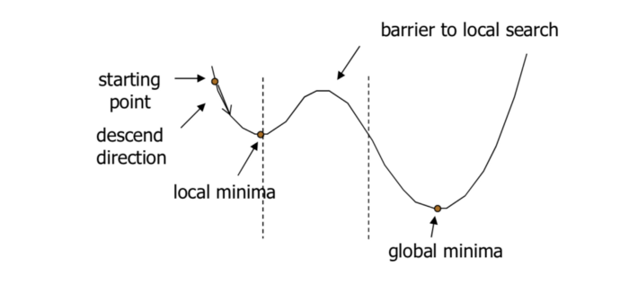
Simulated Annealing
Simulated Annealing (SA) mimics the Physical Annealing process but is used for optimizing parameters in a model. This process is very useful for situations where there are a lot of local minima such that algorithms like Gradient Descent would be stuck at.
In problems like the one above, if Gradient Descent started at the starting point indicated, it would be stuck at the local minima and not be able to reach the global minima.

Slide 19
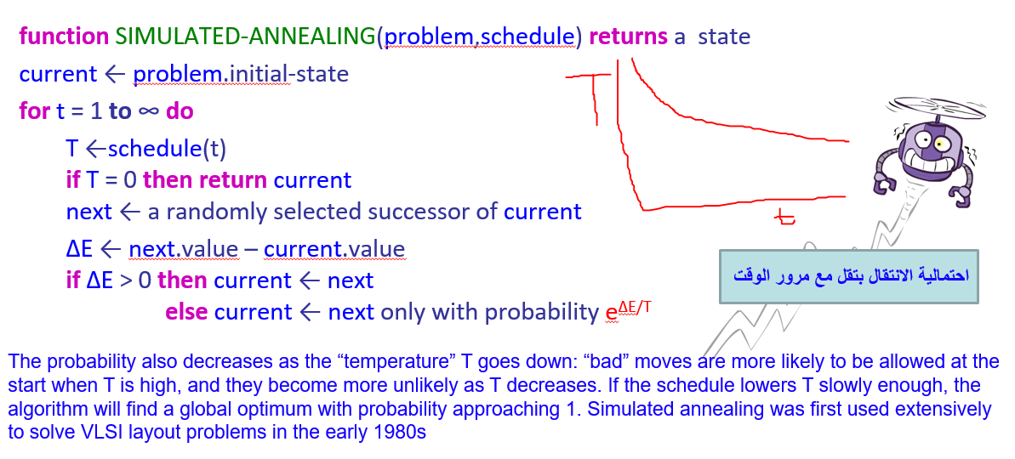
pseudocode

Slide 20
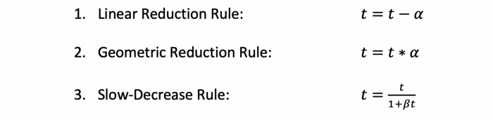
Algorithm
Step 1: We first start with an initial solution s = S₀. This can be any solution that fits the criteria for an acceptable solution. We also start with an initial temperature t = t₀.
Step 2: Setup a temperature reduction function alpha. There are usually 3 main types of temperature reduction rules:
Each reduction rule reduces the temperature at a different rate and each method is better at optimizing a different type of model. For the 3rd rule, beta is an arbitrary constant.
Step 3: Starting at the initial temperature, loop through n iterations of Step 4 and then decrease the temperature according to alpha.
Stop this loop until the termination conditions are reached.
The termination conditions could be reaching some end temperature, reaching some acceptable threshold of performance for a given set of parameters, etc.
The mapping of time to temperature and how fast the temperature decreases is called the Annealing Schedule.

Slide 21
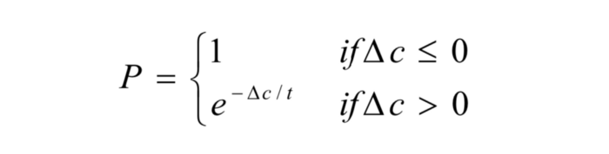
Cont.
Step 4: Given the neighborhood of solutions N(s), pick one of the solutions and calculate the difference in cost between the old solution and the new neighbour solution. The neighborhood of a solution is all solutions that are close to the solution. For example, the neighborhood of a set of 5 parameters might be if we were to change one of the five parameters but keep the remaining four the same.
Step 5: If the difference in cost between the old and new solution is greater than 0 (the new solution is better), then accept the new solution. If the difference in cost is less than 0 (the old solution is better), then generate a random number between 0 and 1 and accept it if it’s under the value calculated from the Energy Magnitude equation from before.
In the Simulated Annealing case, the equation has been altered to the following:
Where the delta c is the change in cost and the t is the current temperature.
The P calculated in this case is the probability that we should accept the new solution.

Slide 22
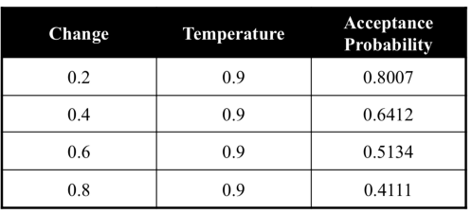
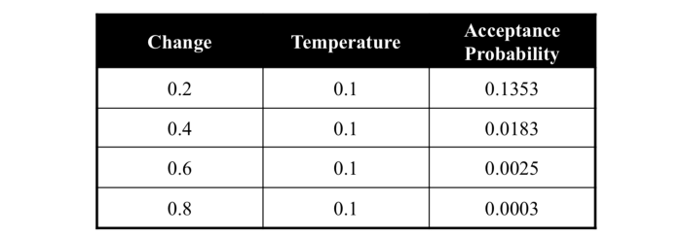
High vs. Low Temperature
Due to the way the probability is calculated, when the temperature is higher, is it more likely that the algorithm accepts a worse solution.
This promotes Exploration of the search space and allows the algorithm to more likely travel down a sub-optimal path to potentially find a global maximum.
When the temperature is lower, the algorithm is less likely or will not to accept a worse solution.
This promotes Exploitation which means that once the algorithm is in the right search space, there is no need to search other sections of the search space and should instead try to converge and find the global maximum.

Slide 23
Advantages vs. Disadvantages of SA
Advantages
Easy to implement and use
Provides optimal solutions to a wide range of problems
Disadvantages
Can take a long time to run if the annealing schedule is very long
There are a lot of tunable parameters in this algorithm

Slide 24
Beam Search Algorithm

Slide 25
Beam Search Algorithm Fundamentals
At a high level, beginning from the start state in some search space, we generate all possible successor states and keep only the “best” k candidates.
We then generate all the successors for those k states, again keep just the top k among these options, and so on.
When the search is over, we go with the best solution found so far.
This is essentially a variant of breadth-first search (BFS), except after we expand all the frontier nodes, instead of keeping every successor state in the frontier,
we only keep the best k. This generates k “beams” that carve through search space, as visualized below with k = 3:

Slide 26
Cont.
This leaves open two questions: how do we decide which states are “best,” and when does the algorithm terminate?
We’ll need some kind of evaluation function for states. If we’re searching for a final goal state,
this function could be a heuristic that estimates how close we are to the goal. In path planning, for example, it could estimate the distance to the destination.
Beam search has many possible terminating conditions.
Perhaps the simplest is to halt as soon as you’ve reached a terminal or goal state.
Another common solution is to halt when it looks like the quality of states is no longer improving significantly, using some heuristic method.

Slide 27
Stochastic Beam Search
Stochastic Beam Search is a variation of the traditional Beam Search algorithm used in various artificial intelligence tasks, particularly in natural language processing and optimization problems. It's designed to address limitations in deterministically selecting the best candidate sequences by introducing randomness into the selection process.
Key Components of Stochastic Beam Search:
Candidate Expansion: Similar to traditional Beam Search, Stochastic Beam Search starts by generating a set of candidate sequences based on a scoring or likelihood metric.
Stochastic Candidate Selection: Instead of deterministically selecting the top candidates based solely on their scores, Stochastic Beam Search introduces stochasticity by using a probability distribution. This distribution guides the probabilistic selection of candidates, allowing for a more diverse set of candidates to be considered.
Diversification: By incorporating randomness into candidate selection, Stochastic Beam Search explores not only high-scoring sequences but also lower-scoring ones, potentially leading to the discovery of alternative paths and better solutions. This diversification helps mitigate the risk of getting stuck in local optima.

Slide 28
Advantages of Stochastic Beam Search
Exploration of Alternative Paths: By allowing lower-scoring candidates to be considered, the algorithm explores a wider range of possibilities, potentially leading to better solutions.
Avoidance of Local Optima: The stochastic nature helps prevent the algorithm from getting trapped in suboptimal solutions by encouraging exploration of diverse sequences.
Generation of Diverse Solutions: Stochasticity introduces diversity in the set of candidate sequences, enabling the algorithm to produce diverse and potentially higher-quality solutions.

Slide 29
Applications of Stochastic Beam Search and considerations
Applications of Stochastic Beam Search:
Natural Language Processing (NLP): Used in tasks like language generation, machine translation, and text summarization.
Optimization Problems: Applicable in optimization tasks with complex solution spaces, such as route planning, scheduling, or parameter optimization in machine learning models.
Considerations:
Balance between Exploration and Exploitation: Tuning the parameters related to stochasticity is crucial to strike a balance between exploring new possibilities and exploiting high-quality candidates.
Performance Impact: Introducing randomness can impact the convergence and efficiency of the search algorithm. Optimizing the stochasticity level is essential to maintain performance.
Stochastic Beam Search offers a trade-off between exploration and exploitation, expanding the search space while aiming to discover more diverse and potentially better solutions compared to deterministic methods. Adjusting the level of stochasticity based on the problem domain and constraints is crucial for optimal performance.

Slide 30
8-Queens problem using Local Search Algorithm.

Slide 31
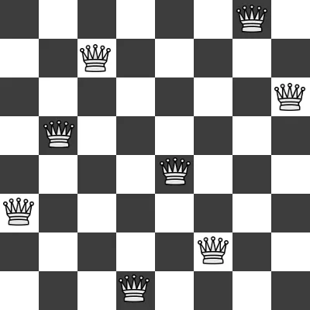
Introduction
The 8-Queens problem is a classic puzzle in the field of computer science and artificial intelligence.
It involves placing eight queens on an 8x8 chessboard in such a way that no two queens threaten each other. In other words, no two queens can be in the same row, column, or diagonal.
This seemingly simple puzzle is a powerful demonstration of problem-solving techniques and is often used to showcase various algorithms.
In this blog, we will explore how to solve the 8-Queens problem using local search algorithms, a class of optimization techniques that iteratively improve a solution until a satisfactory one is found.

Slide 32
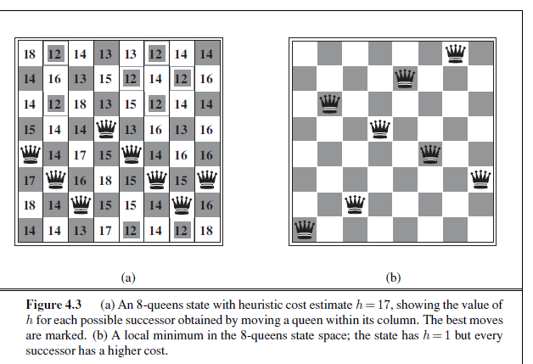
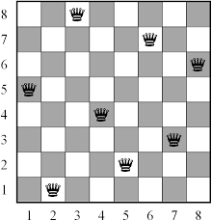

Slide 33
Understanding Local Search Algorithms
Local search algorithms are optimization techniques that start with an initial solution and iteratively make small, incremental changes to it in pursuit of a better solution.
These algorithms are particularly well-suited for solving problems where it is challenging to find the global optimum directly.
Instead, they aim to reach a local optimum — a solution that is better than its immediate neighbors but may not be the absolute best possible.

Slide 34
Solving the 8-Queens Problem with Local Search
To solve the 8-Queens problem using a local search algorithm, we’ll need to define several key components:
1. State Representation:
In this problem, the state represents the positions of the queens on the chessboard. Each state can be represented as an 8-element array, with each element indicating the column number in which the queen is placed in the corresponding row.
2. Objective Function:
We need a way to measure the quality of a solution. In the 8-Queens problem, the objective is to maximize the number of queens that are not attacking each other. We can define a fitness function that calculates the number of non-attacking pairs of queens.
3. Neighbor Generation:
Local search algorithms move from one solution to another by generating neighboring states. For the 8-Queens problem, this involves moving a queen to a different column within the same row.
4. Termination Criteria:
We need to decide when to stop the search. Common termination criteria include a maximum number of iterations or finding a solution with a certain level of fitness.

Slide 35
solution
Now, let’s look at a basic outline of how a local search algorithm can be applied to the 8-Queens problem:
1. Initialization: Start with an initial random or semi-random configuration of queens on the chess-board. 2. Evaluation: Calculate the fitness of the current state using the objective function. 3. Local Search: Repeatedly generate neighboring states and move to the neighbor that has a higher fitness value. If no better neighbor is found, terminate the search. 4. Termination: Stop when a satisfactory solution is found or when a termination criterion is met. 5. Output: Return the final solution, which represents a placement of queens that satisfies the problem’s constraints.

Slide 36
Variations of Local Search Algorithms
Several local search algorithms can be employed to solve the 8-Queens problem effectively. Some of the commonly used ones include:
1. Hill Climbing:
This algorithm iteratively explores neighbors and selects the first neighbor with better fitness. It can get stuck in local optima.
2. Simulated Annealing:
Simulated annealing introduces randomness into the search process, allowing it to escape local optima. It accepts worse neighbors with a decreasing probability, which decreases over time.

Slide 37
Conclusion
Solving the 8-Queens problem using local search algorithms is a fascinating exercise in optimization and problem-solving.
By representing the problem state, defining an objective function, generating neighbors, and implementing termination criteria, we can effectively navigate the solution space to find a valid placement of eight queens on the chessboard.

